Slide 1

Unity 3D Essentials
2D Mode & Particles
SoftUni Team
Technical trainers
Software University
https://softuni.org

Slide 2

Table of Contents
Editor, Camera & Sprites for 2D
2D Rendering & Layers
2D Physics
Particles
Useful links

Slide 3
Have a Question?
sli.do
#Unity3D-Basics
Notes:
‹#›

Slide 4

2D Mode, Camera & Sprites for 2D

Slide 5
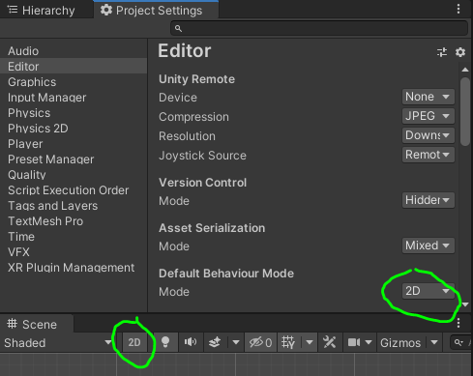
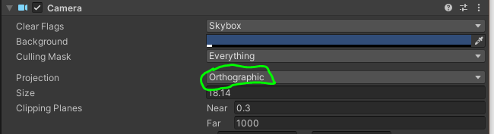
2D Mode
Editor Settings
Camera differences

Slide 6
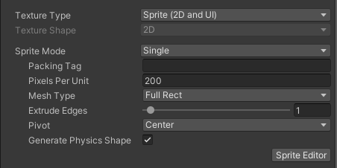
Sprites
Sprites
Import Settings
Sprite Editor
Single/Multiple Sprites
Slicing

Slide 7

2D Rendering & Layers

Slide 8
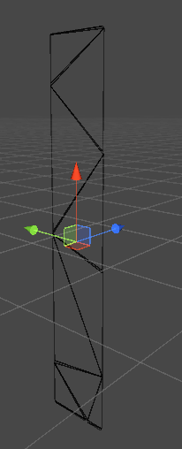
2D vs 3D Rendering
Orthographic View
Mesh Differences?
Sprite Renderer

Slide 9
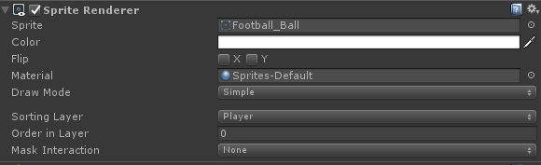
Layers
Order of rendering
Sprite Mask
Sorting layer
Order in layer
zIndex

Slide 10

2D Physics

Slide 11
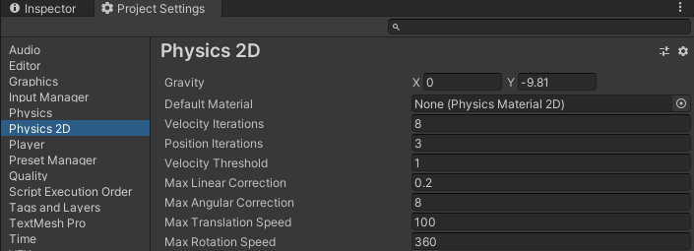
2D Physics Manager
Gravity
Collision Matrix
Differences with 3D?

Slide 12
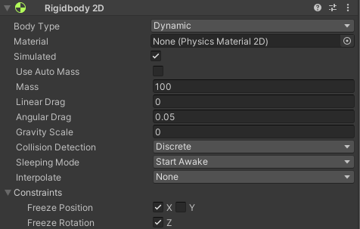
2D Rigidbody
Body Type
Simulated
Auto Mass
Gravity Scale
Sleeping Mode

Slide 13
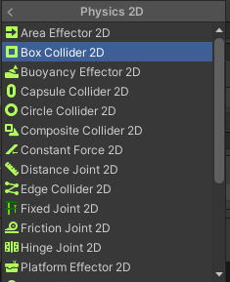
2D Collisions
Detection Methods
Trigger
Normal
Common Colliders
Box
Capsule
Circle
Composite
Edge

Slide 14
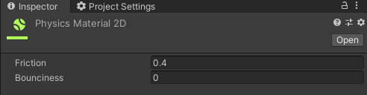
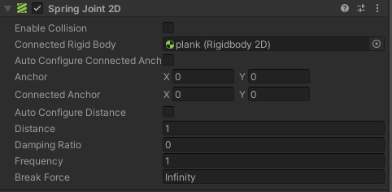
Physics Material & Joints
2D Physics Material
Friction
Bouncines
2D Popular Joints
Spring
Distance
Hinge
Wheel

Slide 15

Particles

Slide 16
Particles
What is particle
Small 2D piece generated automatically
Unity Particle System
Tons of adjustment
2D Rendering with layers & materials in its root nature

Slide 17
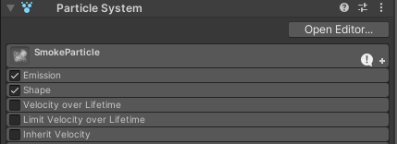
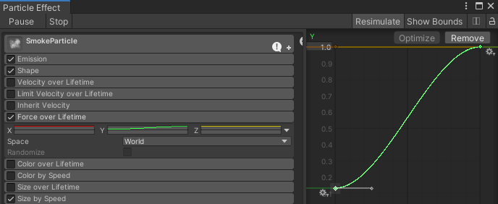
Particles
Inspector
General Adjusting
Editor
Detailed
Popular types of behaviors
Constant/Fixed
Range
Curve

Slide 18
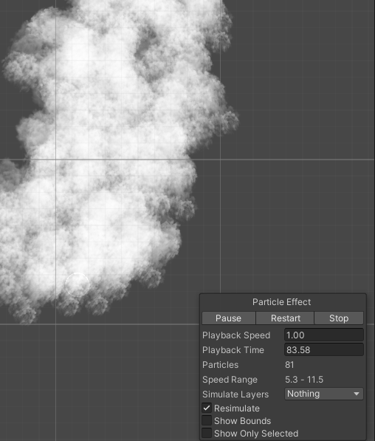
Particles
Example Smoke
Smoke Texture
Generation (emit) rate
Direction
Size over lifetime

Slide 19
Particles Simple Scripting
public ParticleSystem smoke;
public void FixedUpdate()
{
if (Input.GetKey(KeyCode.LeftShift))
{
ParticleSystem.MainModule mainModule = smoke.main;
mainModule.startColor = Color.red;
smoke.Play(true);
}
else
{
smoke.Stop(true);
}
}

Slide 20
Useful Links
http://docs.unity3d.com/Manual/class-SpriteRenderer.html
http://docs.unity3d.com/Manual/class-TagManager.html
http://docs.unity3d.com/Manual/class-Rigidbody2D.html
http://docs.unity3d.com/ScriptReference/ParticleSystem.html
Free Particle systems

Slide 21

Summary
Editor, Camera & Sprites for 2D
2D Rendering & Layers
2D Physics
Particles
Useful links
Notes:
‹#›

Slide 22
Questions?
Email : dstrashilov@gmail.com
Notes:
‹#›

Slide 23

License
This course (slides, examples, demos, exercises, homework, documents, videos and other assets) is copyrighted content
Unauthorized copy, reproduction or use is illegal
© SoftUni – https://about.softuni.bg
© Software University – https://softuni.bg
Notes:
‹#›

Slide 24
Trainings @ Software University (SoftUni)
Software University – High-Quality Education, Profession and Job for Software Developers
about.softuni.bg, softuni.org
Software University Foundation
softuni.foundation
Software University @ Facebook
facebook.com/SoftwareUniversity
Software University Forums
forum.softuni.bg
Notes:
‹#›

